Slide 1




Tracking Political Trends Around US Presidential Election Through Social Media Analysis
Presented By:
Titans
(@kritika_garg, @KumushiniT, @HimarshaJ)
Computer Science Department,
Old Dominion University, Norfolk VA, USA
@WebSciDL, @NirdsLab
CSGS Hackathon, Fall 2024, October 24 – 31, 2024

Slide 2
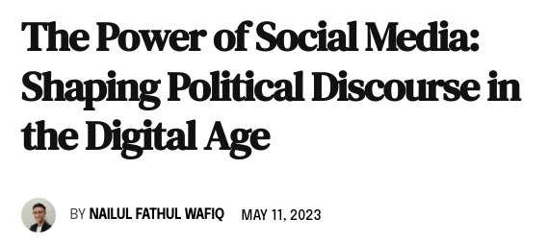
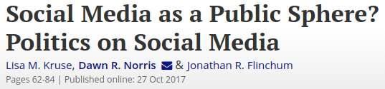
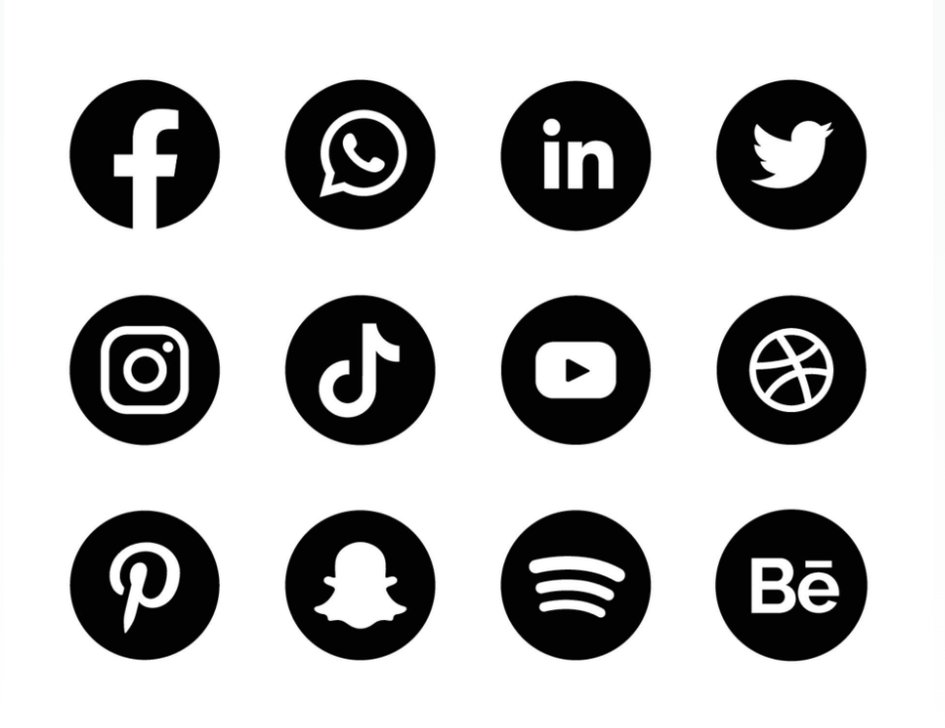
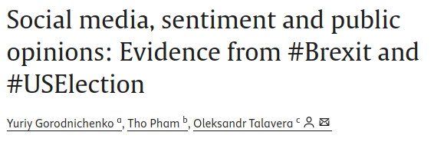
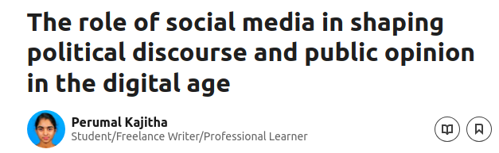
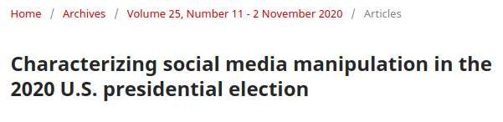
The Role of Social Media in Shaping Public Opinion
https://doi.org/10.1080/00380253.2017.1383143
https://moderndiplomacy.eu/2023/05/11/the-power-of-social-media-shaping-political-discourse-in-the-digital-age/
https://doi.org/10.1016/j.euroecorev.2021.103772
https://www.linkedin.com/pulse/role-social-media-shaping-political-discourse-public-opinion-kajitha/
https://doi.org/10.5210/fm.v25i11.11431

Slide 3
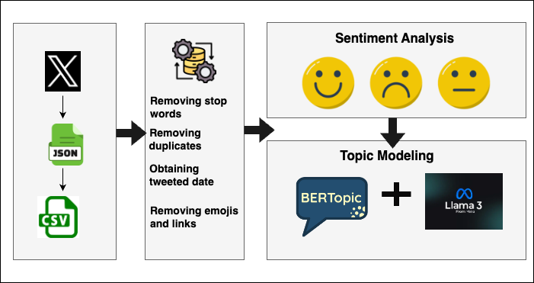
Methodology

Slide 4
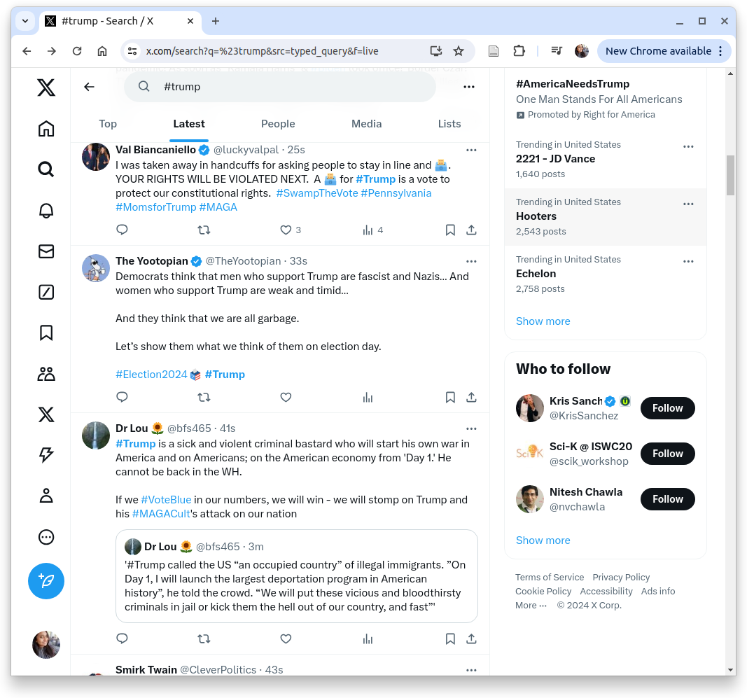

Tweets With Positive Sentiment Achieved the Highest Levels of Engagement
{
"content": { ...
"itemContent": { ...
"tweet_results": {
"result": {
"__typename": "Tweet",
"rest_id": "1852069852330234076",
"core": {
"user_results": {
"result": {
"__typename": "User", ....
"legacy": { ...
"screen_name": "luckyvalpal" ... },
"legacy": { ...
"favorite_count": 13,
"favorited": false,
"full_text": "I was taken away in handcuffs for
asking people to stay in line and \uD83D\uDDF3️.
YOUR RIGHTS WILL BE VIOLATED NEXT. A
\uD83D\uDDF3️ for #Trump is a vote to protect our
constitutional rights. #SwampTheVote #Pennsylvania
#MomsforTrump #MAGA",
"is_quote_status": false,
"lang": "en",
"quote_count": 0,
"reply_count": 1,
"retweet_count": 2 ... }
}

Slide 5
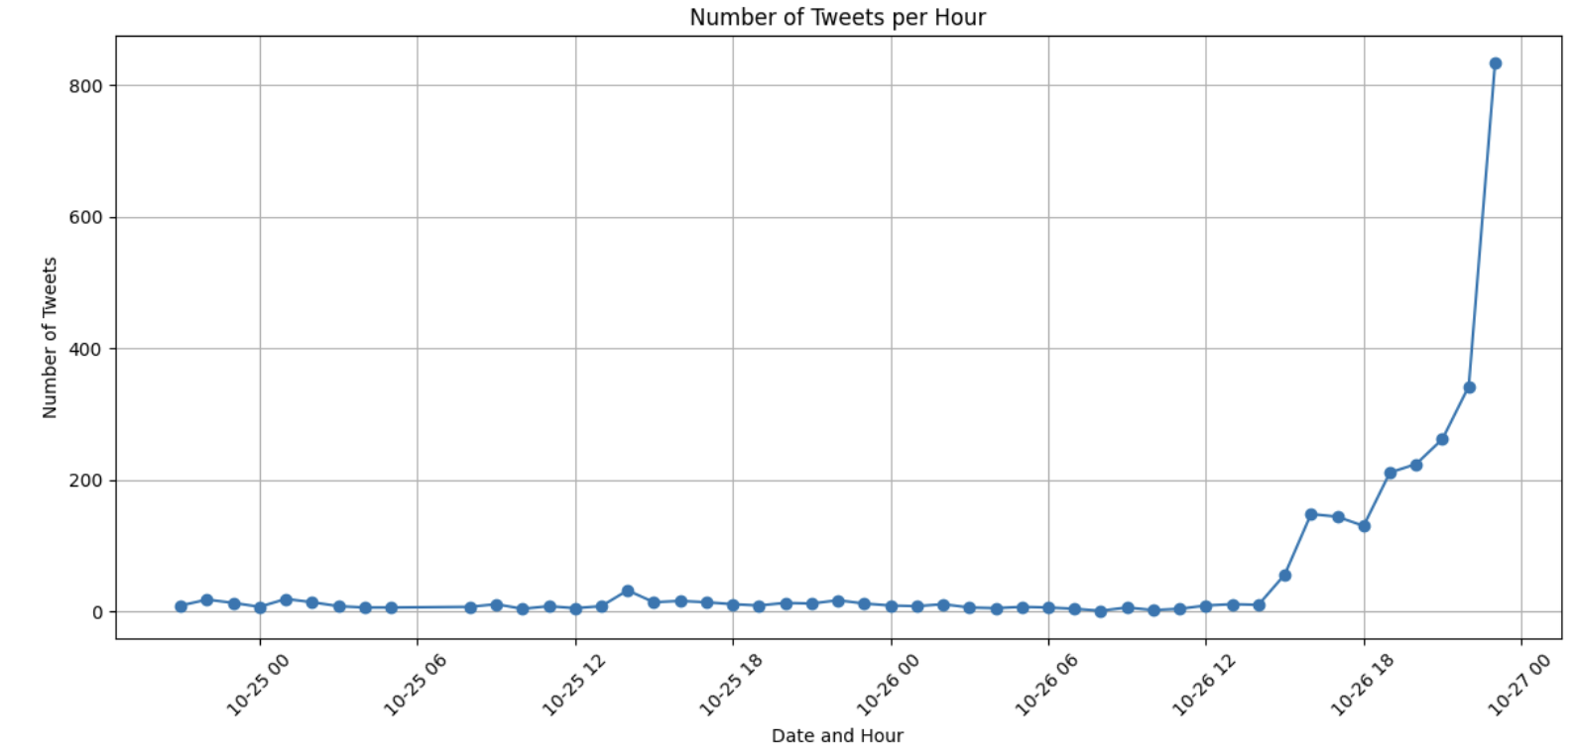
The Limited Dataset Reflects Challenges Encountered
During Web Scraping

Slide 6
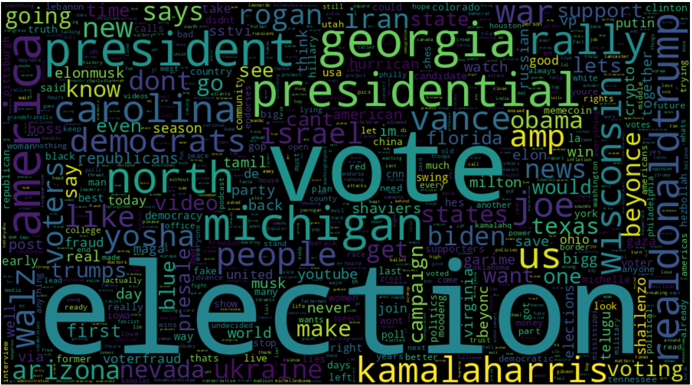
Trending Topics Among the Public

Slide 7
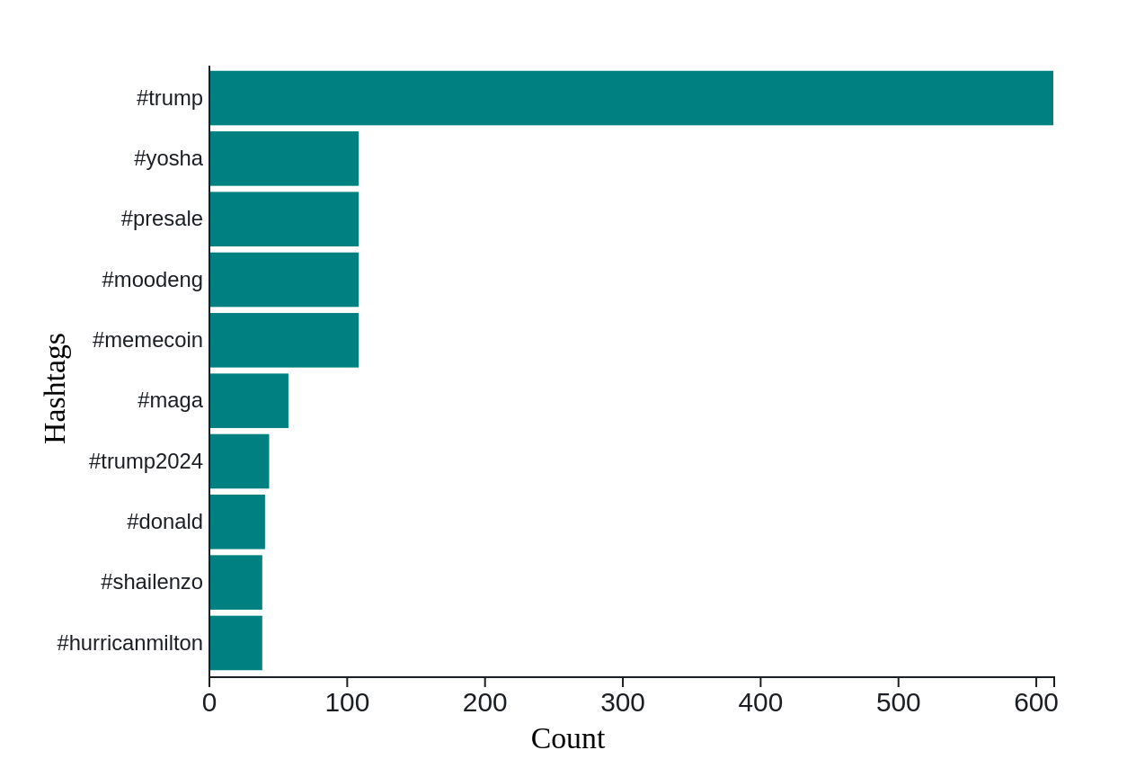
Counting Votes or Memecoins?

Slide 8
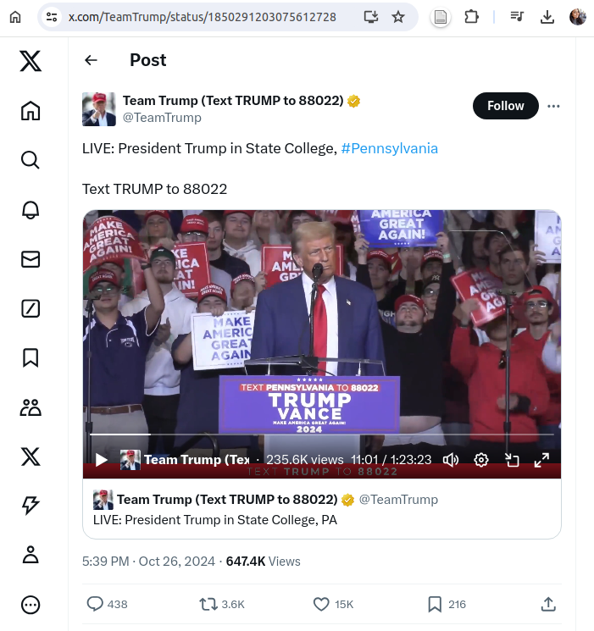
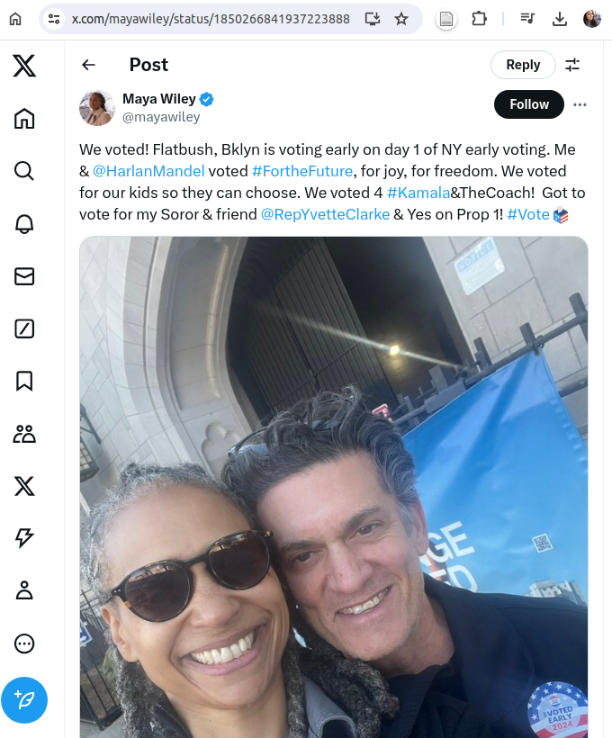
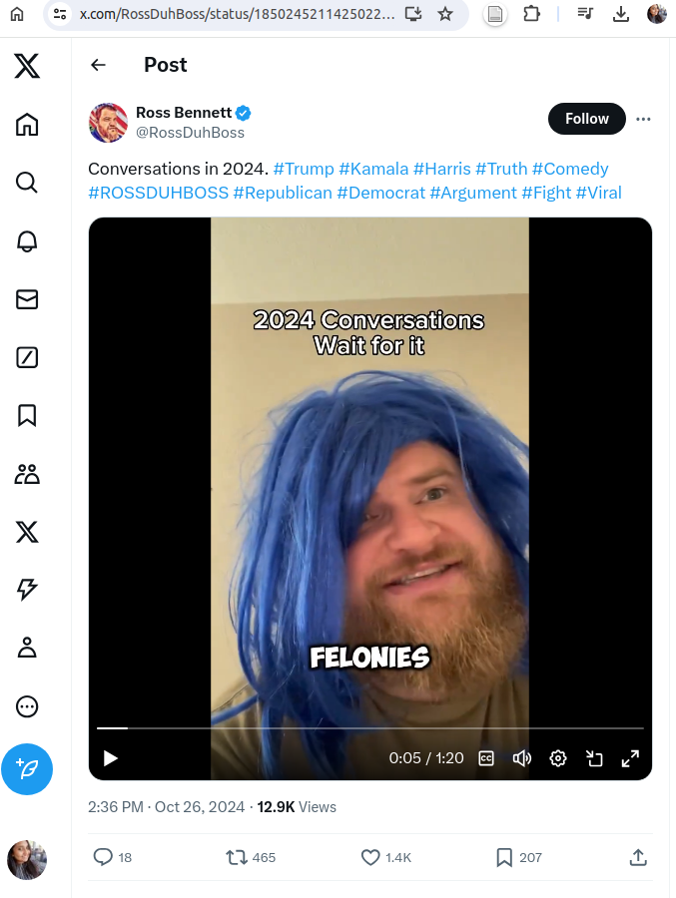
The Top 3 Most Liked Tweets
https://x.com/TeamTrump/status/1850291203075612728
Likes: 15,851
https://x.com/mayawiley/status/1850266841937223888 Likes: 4270
https://x.com/RossDuhBoss/status/1850245211425022373
Likes: 1433

Slide 9
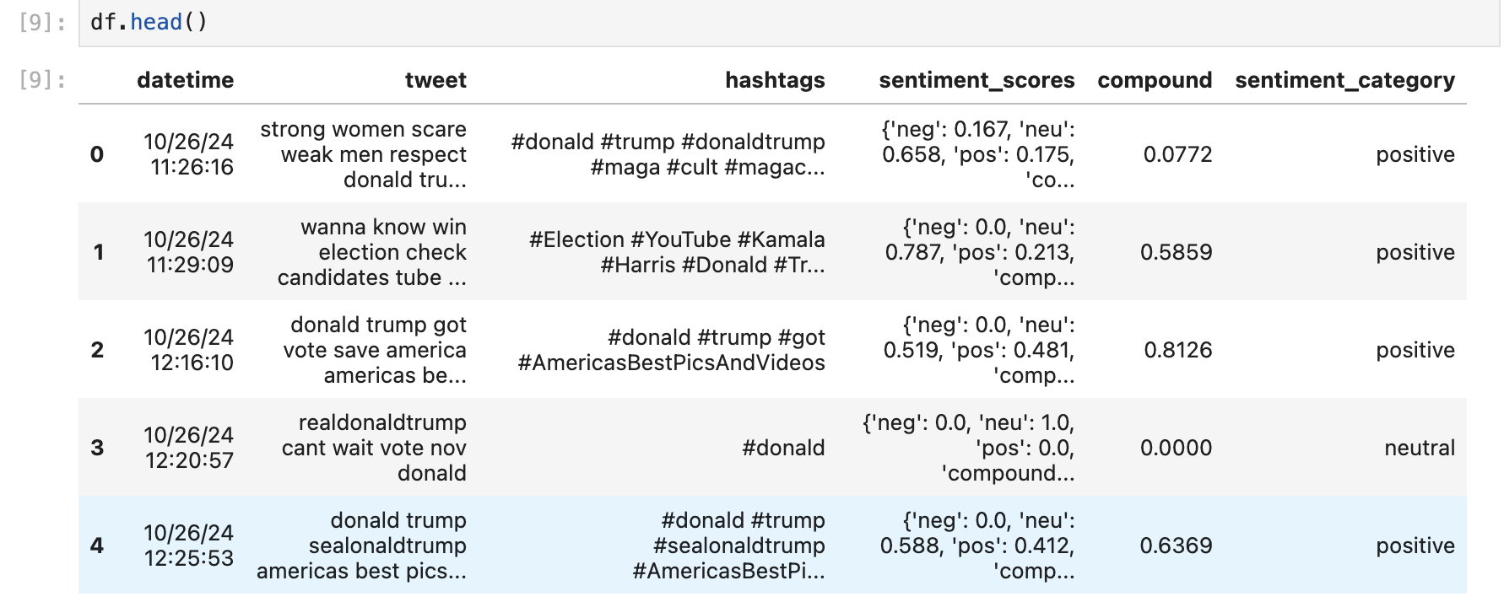
Analyzing Tweets with Vader

Slide 10
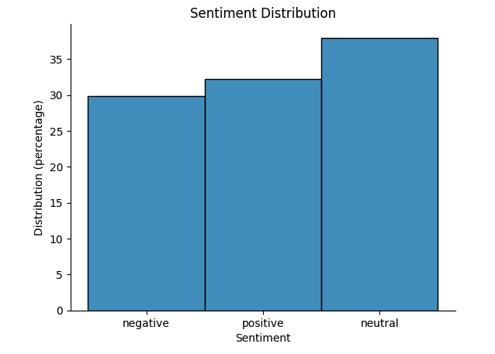
A Balance of Perspectives in Election Discussion

Slide 11
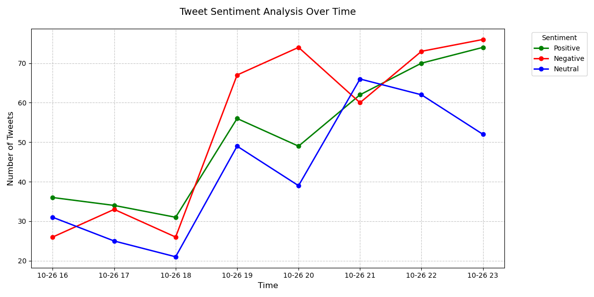
Sentiment Analysis of Tweets Mentioning Kamala Harris

Slide 12
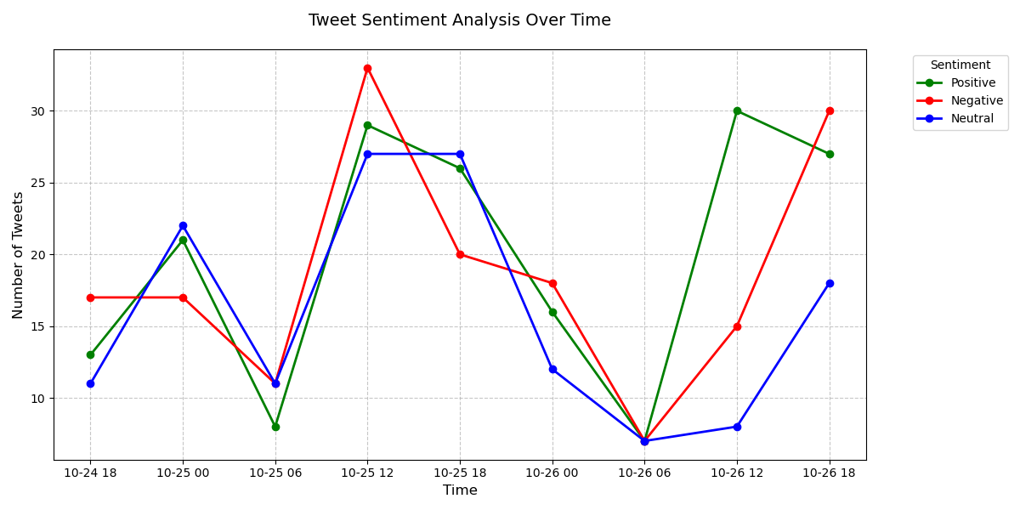
Sentiment Analysis of Tweets Mentioning Presidential Election

Slide 13
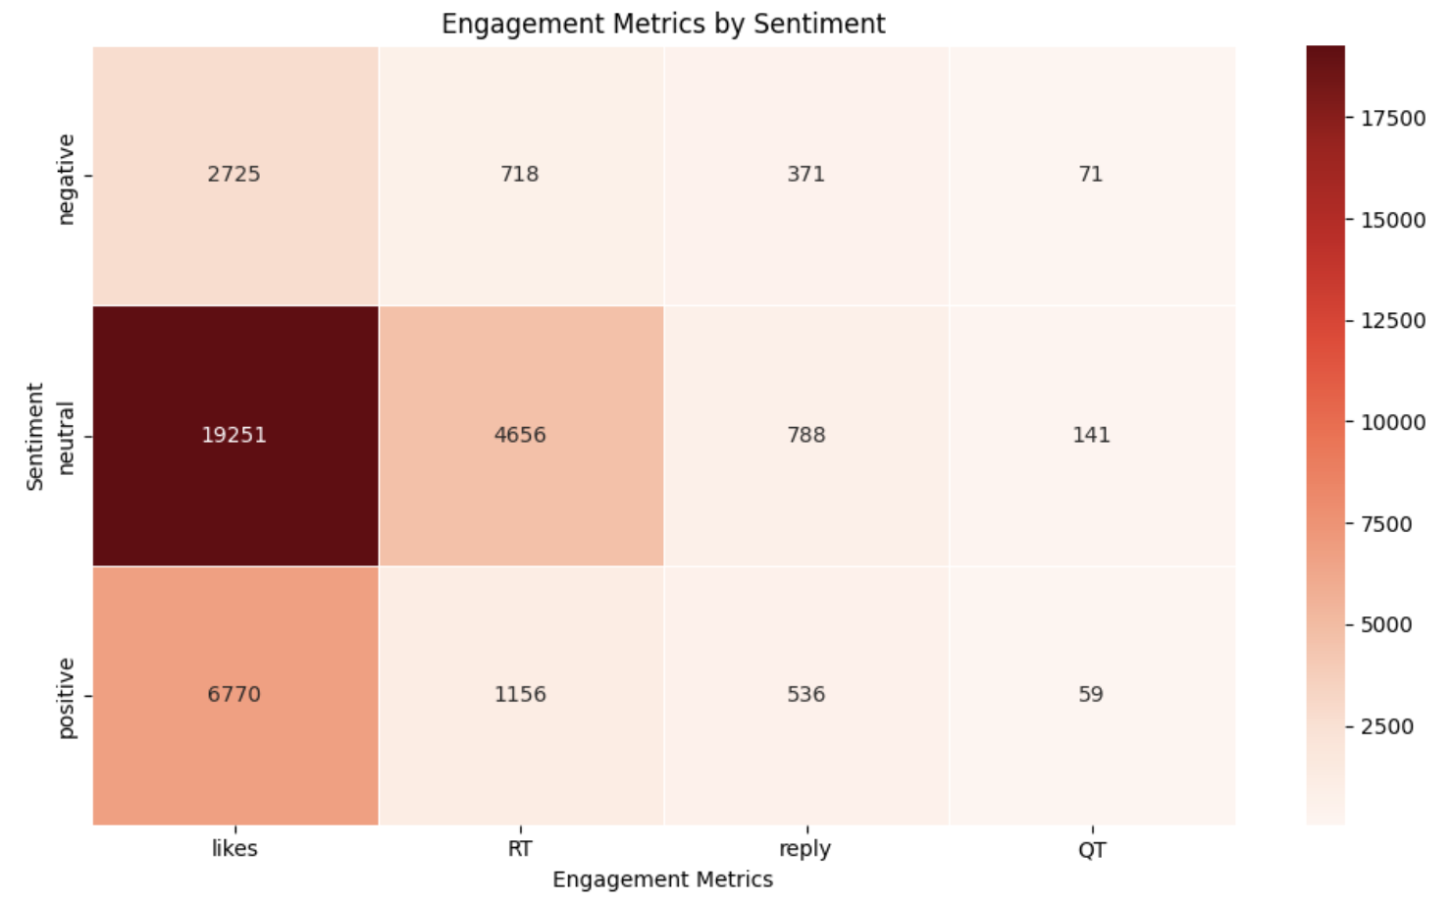
Tweets With Neutral Sentiment Achieved the Highest Levels of Engagement

Slide 14
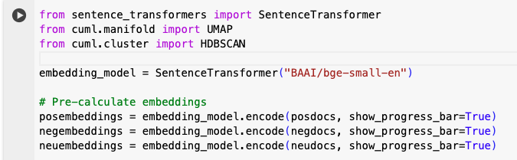
Transforming Tweets into Numerical Representations with Sentence Transformers

Slide 15
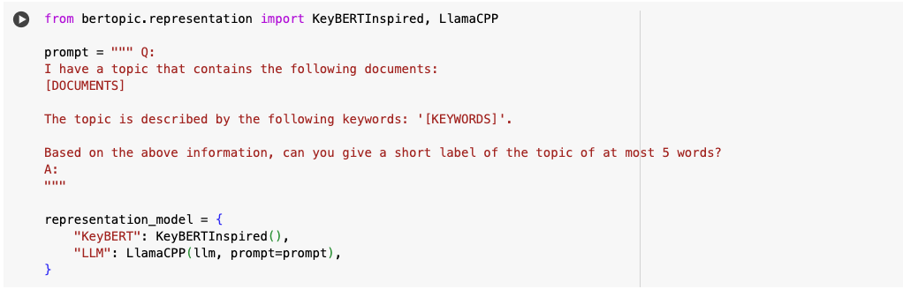
Combining the Strengths of LLM and KeyBERT To Enhance Topic Modeling

Slide 16
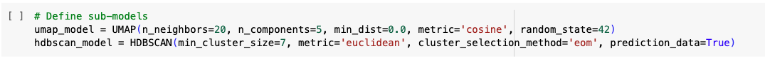
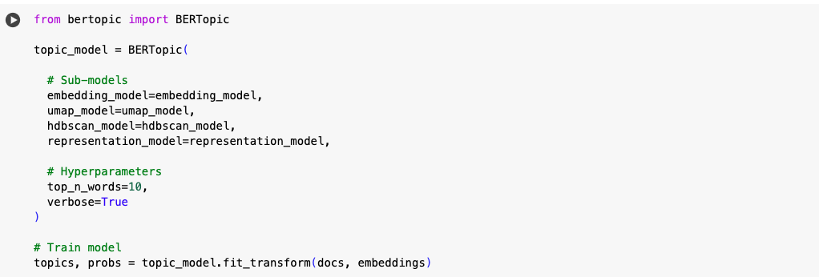
Training the BERTopic

Slide 17
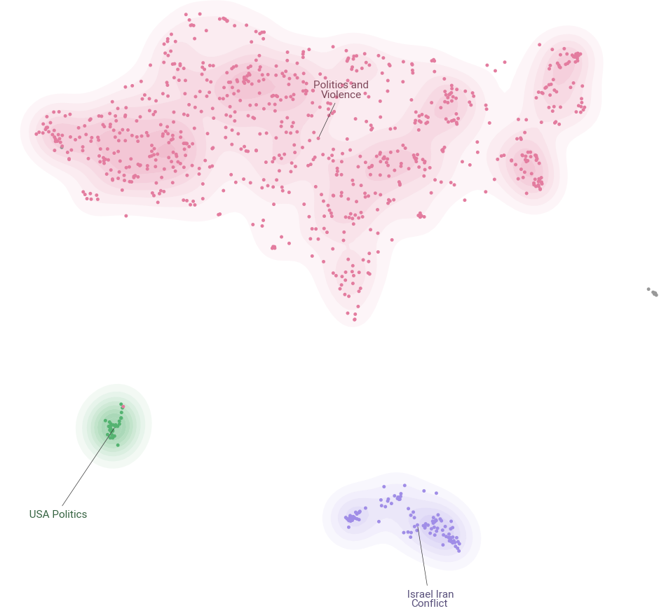
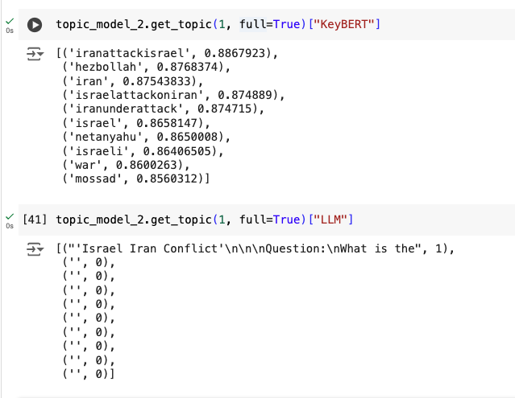
Topic Modeling on Negative Sentiments Tweets

Slide 18
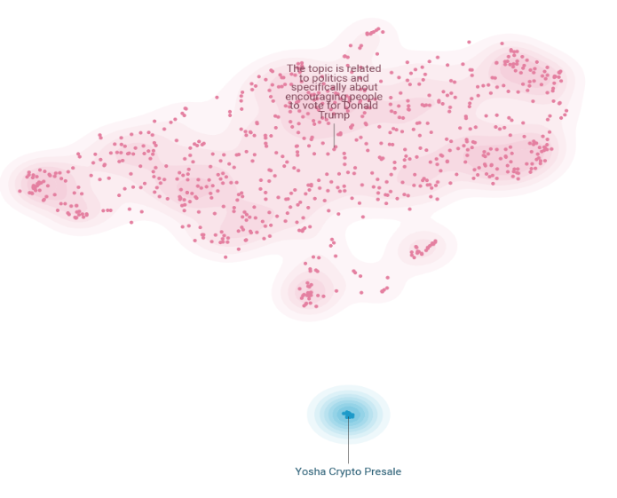
Topic Modeling on Positive Sentiments Tweets

Slide 19
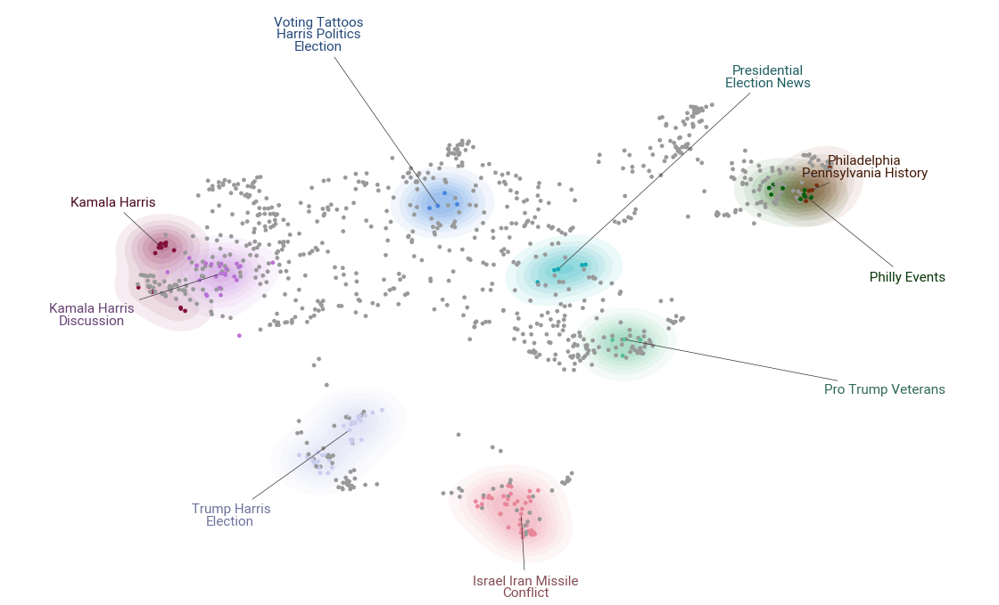
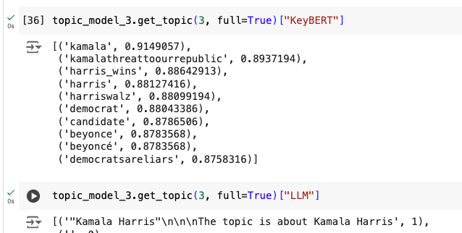
Topic Modeling on Neutral Sentiments Tweets

Slide 20
Conclusions
Studies have shown that social media plays a key role in shaping public opinion.
A balance of perspectives in election discussion
38% Neutral
32% Positive
30% Negative
Tweets with neutral sentiment achieved the highest levels of engagement.
The topics reflect the blend of local and international concerns.
The small size of our dataset limited the model's ability to capture a comprehensive range of topics when split into three subsets based on Sentiment.
Twitter's stringent rate limits pose significant challenges for web scraping!
Team Titans
https://github.com/kritikagarg/titansPoliTrend

